Slide 1
Gender and Development:
Concepts and Programming
Syed M Hashemi
September 23, 2021

Slide 2
Sex and Gender
Sex:
Biological characteristics (including genetics, anatomy and physiology) that generally define humans as female or male
Gender:
Socially constructed set of roles and responsibilities associated with being girl and boy or women and men; learned behavior
Example: The expectation of men to be economic providers of the family and for women to be caregivers is a gender norm in many cultural contexts
What are some of the gender roles we experience in middle class urban households ?
Photo Credit: The World Bank
Photo Credit: BOMA

Slide 3
Sex versus Gender: Statements on Men and Women
1. Women give birth to babies, men don't
2. Girls are gentle, boys are rough
3. Women agriculture workers receive less pay than men
4. Truck drivers in Bangladesh are all men
5. Women can breastfeed babies, men can bottle-feed babies
6. Sons receive twice as much inheritance as daughters
7. Women do 67% of the world's work, yet their earnings for it amount to only 10% of the world's income
8. There are more women than men in nursing
Photo Credit: The World Bank
Photo Credit: BOMA

Slide 4
Sex versus Gender: Statements on Men and Women
1. Women give birth to babies, men don't (S)
2. Girls are gentle, boys are rough (G)
3. Women agriculture workers receive less pay than men (G)
4. Truck drivers in Bangladesh are all men (G)
5. Women can breastfeed babies, men can bottle-feed babies (S)
6. Sons receive twice as much inheritance as daughters (G)
7. Women do 67% of the world's work, yet their earnings for it amount to only 10% of the world's income (G)
8. There are more women than men in nursing (G)
Photo Credit: The World Bank
Photo Credit: BOMA

Slide 5



EXERCISE: RIDDLE
???
A boy and his father are in a car accident.
The father is taken to one hospital.
The boy is taken to another hospital.
The surgeon says, "I can't operate on this boy. He is my son!“
Who is the surgeon?
Notes:
SLIDE CONTENT: Let’s start this session with a riddle. I’ll read through it and at the end ask you to think of the answer.
EXERCISE: Riddle
Share the following riddle with participants. Note that the riddle will not work in countries where the word for doctor or surgeon is not gender neutral. If there is a different word or word ending for a male and female doctor and you can not find a suitable neutral term that does not indicate gender, skip this exercise.
A father and his son were travelling in a car when they were involved in a terrible accident. The father was not badly hurt but the son was in critical condition. The father was sent to one hospital while the son was sent to another. When the son arrived, the surgeon looked down at him and said “I can’t operate on this boy. He is my son.”
Ask the participants what the relationship is between the surgeon and the boy. Who is the surgeon? Have participants write their answers on a piece of paper before asking for volunteers to share their answers. After a few people have had a chance to guess, reveal the answer: the surgeon was his MOTHER!
If no one thought of this answer, ask why that might be. Use this riddle to point out that all of us have perceptions that shape our ideas about what men and women do in our society. In many societies, women are nurses and men are doctors. While this is slowly changing, the perceptions remain.

Slide 6
Concepts: Gender Equality and Gender Equity
Gender Equality:
The state or condition that affords women and men equal human rights, and equal opportunities and resources, to contribute to, and benefit from, all spheres of society (economic, political, social, and cultural)
Gender Equity:
Justice and fairness in the treatment of women and men in order to eventually achieve gender equality, often requesting differential treatment of women and men (or specific measures) in order to compensate for the historical and social disadvantages that prevent women and men from sharing a level playing field.
Achieving greater equality between women and men require changes at many levels, including changes in attitudes and relationships, changes in institutions and legal frameworks, changes in economic institutions, and changes in political decision-making structures
Photo Credit: The World Bank
Photo Credit: BOMA

Slide 7
Patterns of Gender Inequality
Inequalities in political power and representation:
Women are often underrepresented in formal decision-making structures, including governments, community councils, and policy-making institutions.
Inequalities in economic participation and opportunities:
In most countries, women are receiving lower wages for similar work, are more likely to be in low-paid jobs and unsecured work (part-time, temporary, home-based) and are likely to have less access than men to productive assets such as education, skills, property and credit.
Educational attainment:
In most countries women have lower literacy rate, lower level of enrolment in primary, secondary and tertiary education.
Sexual and domestic violence:
Women tend to be more often victims of domestic violence, sexual exploitation through trafficking and sex trade and rape in wars.
Differences in legal status and entitlements:
Equal rights to personal status, security, land, inheritance, employment opportunities often denied to women by law or practice.
Photo Credit: The World Bank
Photo Credit: BOMA

Slide 8
Gender Mainstreaming
Gender Mainstreaming:
The systematic integration of the respective needs, interests and priorities of men and women in all the organization’s policies and activities. This rejects the idea that gender is a separate issue and something to be tacked on as an afterthought.
Evolution of Gender Mainstreaming:
1985: Concept first introduced (Nairobi)
1995: Further developed at UN Fourth World Conference on Women (Beijing)
Beijing Platform: “Promote an active and visible policy of mainstreaming a gender perspective”
From WID to GAD
Women in Development (70s $ 80s): Analysis focused on women; Programs exclusively for women
Gender & Development (1990s): Analysis focused on social, economic, political and cultural forces that determine how men and women participate in, benefit from, and control project resources and activities differently
The GAD approach promotes a development process that transforms gender relations in order to enable women to participate on an equal basis with men in determining their common future
Photo Credit: The World Bank
Photo Credit: BOMA

Slide 9
Gender Mainstreaming: Strategies & Tools
Involve women and men in consultations
Include sex-disaggregated data
Formulate gender-sensitive and/or specific objectives, indicators and activities
Strive for gender balance in staff/experts
Enable women and men to participate equally and benefit equally
Include gender in program design
Include gender in evaluations
Always ask: “How will this affect women and men?”
Photo Credit: The World Bank
Photo Credit: BOMA

Slide 10
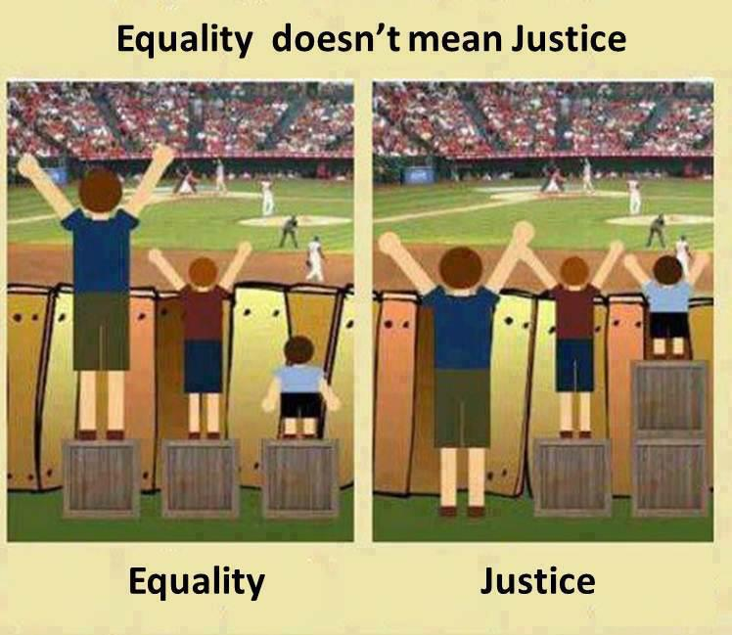
Compensating for inequities:
Need For Affirmative Action
Image: Iris de Caluwe
Notes:
SLIDE CONTENT: Let’s return to the concept of equality. The image on the slide provides a great illustration of the problem with “formal equality”. Remember that the formal equality approach assumes that men and women are the same and thus the goal is to treat them the same, regardless of their biological and gender differences. In this image, on the “equality side” you see three boys of varying heights who are trying to watch a sports event. They are each standing on a box of the same size, so they are being treated equally but the results are not equal, are they?
Compare that with the “Justice side” in which the boxes have been shifted between them based on their needs so that all three of them can see over the fence. While this image refers to this as “justice”, it could also be called “substantive equality” as it calls for a similar approach.
Remember that substantive equality is a corrective approach that recognizes that some people are in an unequal position and need to be treated differently in order to benefit equally. It affirms that proactive measures may be needed to bring about equality, accelerate social change and help correct historical, systemic and structural imbalances.
Let’s talk briefly about how to compensate for inequities.

Slide 11
Women are not a Homogenous Group
Differences exist due to:
  Class
  Location
  Ethnicity
  Religion
  Age
  Education
  Language
  Disabilities
Important to distinguish when designing programs
Photo Credit: The World Bank
Photo Credit: BOMA

Slide 12
Bangladesh is a Signatory to CEDAW
The United Nations Convention on the Elimination of all Forms of Discrimination against Women (CEDAW) defines discrimination against women as “any distinction, exclusion or restriction made on the basis of sex which has the effect or purpose of impairing or nullifying the recognition, enjoyment or exercise by women, irrespective of their marital status, on a basis of equality of men and women, of human rights and fundamental freedoms in the political, economic, social, cultural, civil or any other field.” (1979)
Photo Credit: The World Bank
Photo Credit: BOMA

Slide 13
Beijing Declaration and Platform for Action: 1995
The outcome document of the Fourth World Conference on Women in September 1995, considered as blueprint for improving position of women and advancing women’s rights.
Strategic Objectives
Women and Poverty:
Revise laws and administrative practices to ensure women’s equal rights and access to economic resources.
Women and the Economy:
Promote women’s economic rights and independence, including access to employment and appropriate working conditions and control over economic resources; Strengthen women’s economic capacity and eliminate all forms of employment discrimination.
Women in Power and Decision-Making:
Take measures to ensure women’s equal access to and full participation in power structures and decision-making.
Integrate gender perspectives in legislation, public policies, programs and projects.
Photo Credit: The World Bank
Photo Credit: BOMA

Slide 14
Conceptualizing Women’s Empowerment
Women’s Empowerment is more than access to resources, markets and services (Economic Empowerment)
Empowerment is about building critical consciousness and agency
unless women are liberated from their existing perception of themselves as weak, inferior and limited beings, no amount of external interventions … will enable them to challenge existing power equations in society, the community or the family (Batliwala)
Empowerment is about changing power relations
collective actions exercising women’s agency to transform oppressive power relations to address the structural basis of gender inequality
Empowerment is about process
The work of external actors is not ‘empowering women’ but clearing some of the obstacles from this path
Source: Andrea Cornwall, Women’s Empowerment: What Works and Why
Photo Credit: The World Bank
Photo Credit: BOMA

Slide 15
Intensifying the Gender Approach
What can we do to make economic inclusion programs more gender intentional ?
target, more effectively, vulnerable and invisible women
create non-traditional businesses and economic opportunities for women
link to value chains; create producer companies
provide legal ownership of land and productive assets
intensify financial inclusion efforts
ease access to public services
ensure birth registration and marriage registration
educate on divorce, dowry, child marriage, inheritance laws
build awareness of domestic violence, sexual abuse and trafficking
Photo Credit: The World Bank
Photo Credit: BOMA

Slide 16
Setting a Gender Transformational Agenda
For those intent on going beyond economic empowerment:
understand the local context of gender subordination and the intersectionality with race, class, ethnicity
build group solidarity and facilitate consciousness raising through understanding of rights and violations of existing laws
promote non-traditional high value economic opportunities, especially through increased control of value chains
assist women in organizing against sexual intimidation and violence
assist women in understanding local government and running for local office
leverage with rights groups and other organizations
Ensure women’s agency: It is for them to understand, articulate, weigh choices, determine course of action and provide leadership
Photo Credit: The World Bank
Photo Credit: BOMA

